Slide 1
KnightBites
David Barry, Kenny Howes,
Lujia Li, Peter Lund, Lily McAboy, Jacob Tocila
Notes:
David

Slide 2

The Vision
Platform to make informed meal choices.
Dining halls adjust offerings based on feedback
Improves campus dining experience through real-time feedback.

Slide 3
Demonstration
With online help!
Notes:
Lily

Slide 4
Technologies
Notes:
Kenny

Slide 5
React Native
Mobile app development framework
Component based architecture
Less time rewriting same code
Tested with Expo

Slide 6
Azure
Service
Web service
Node.js 20 stack
Proxies database with REST API
Database
PostgreSQL DBMS
Schema based on domain model

Slide 7
Analysis & Design
Notes:
Jacob

Slide 8
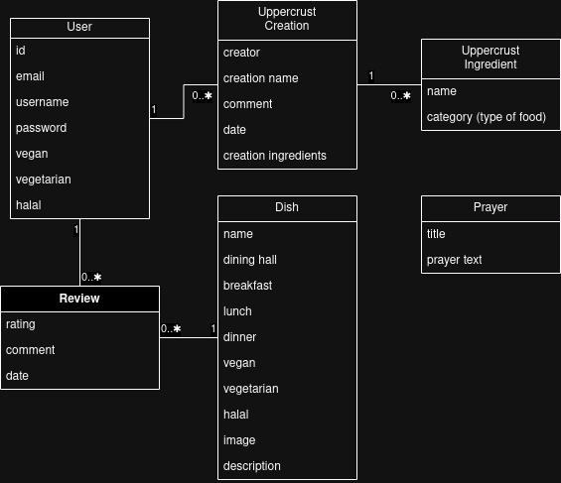
Information System
Relational database
Schema developed from domain diagram
Notes:
As we’ve seen throughout the demo…
one user can have many ratings and comments for one dish.
one dish can have many ratings and comments from many users.

Slide 9
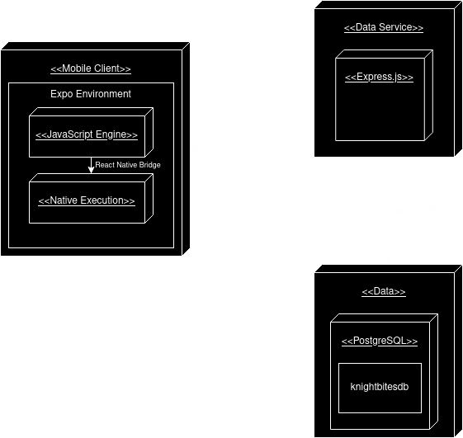
Deployment Diagram
Mobile Client
Data Service
Data

Slide 10
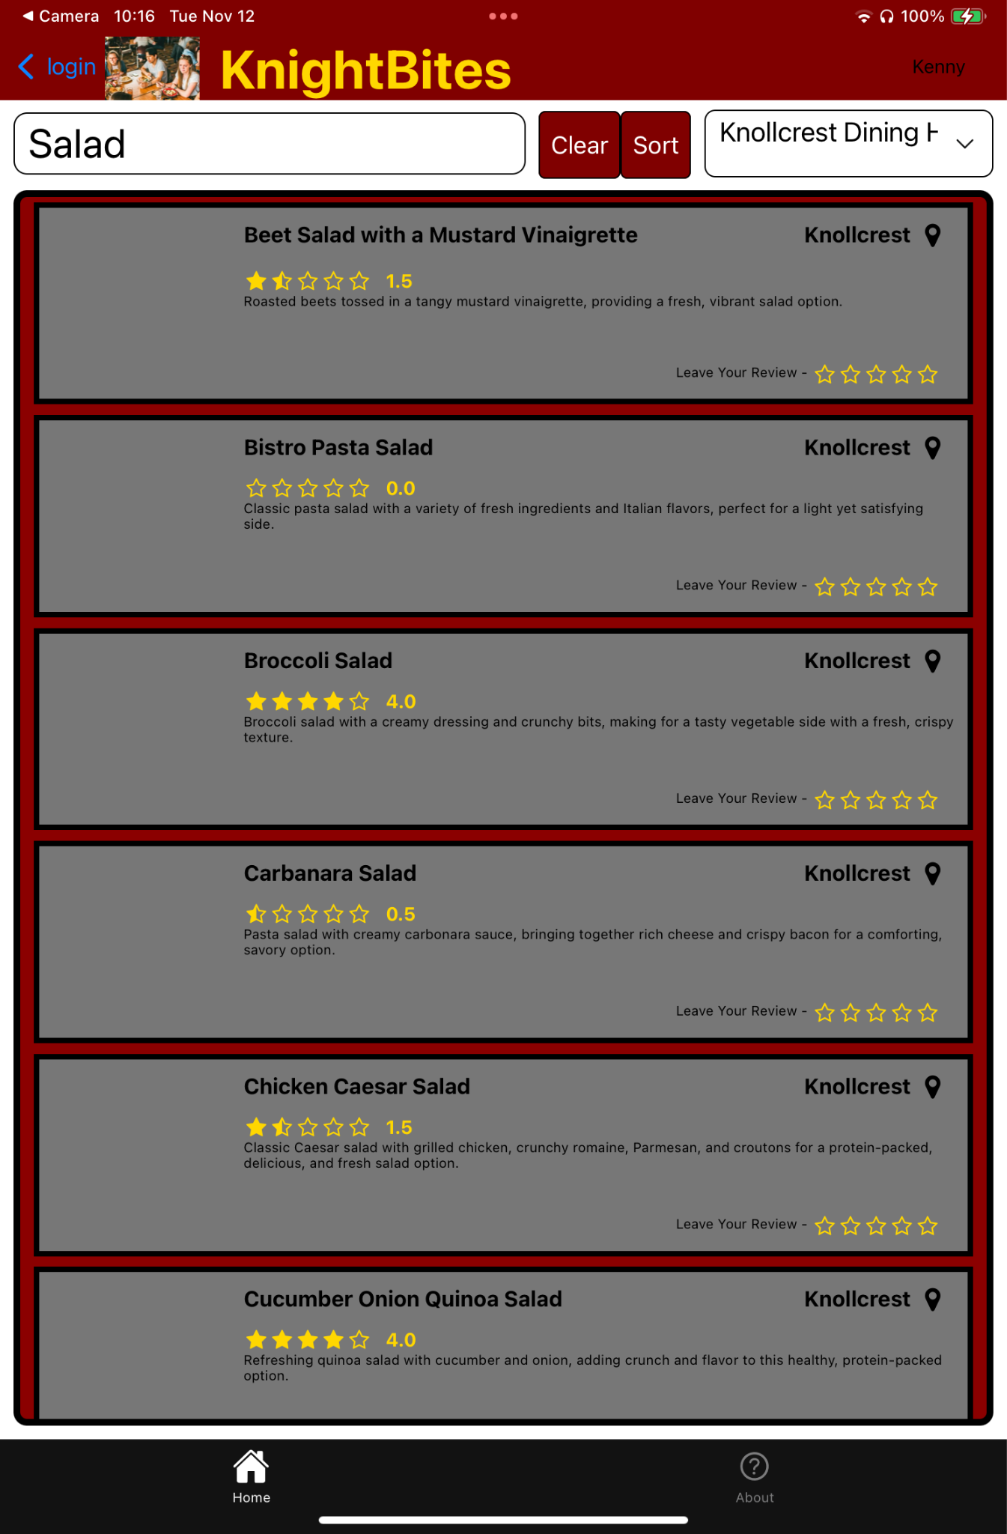
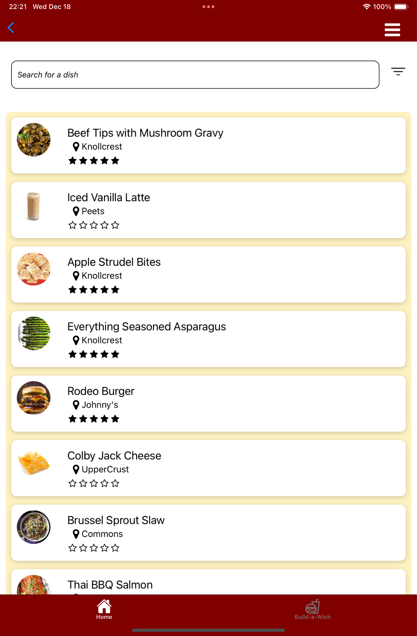
UI Changes

Slide 11
Assessment
Notes:
Lily

Slide 12
Changes From Usability Tests
Prayer Page
FAQ
Having a filter to sort by dining hall, meal time, and blah blah blah
Jacob finish this slide ok

Slide 13
Strengths and Weaknesses
Strengths
Strong data and service
User subsystem
Essentially 2 apps in one (View and Rank, UpperCrust Sandwiches)
Weaknesses
Database changes don’t update in real time
Notes:
Current:
Clear layout and organized design make it easy for user to find and use features.
We used Calvin Maroon and Gold, reflecting Calvin’s brand, creating familiarity for students.
Standardized styles for buttons and text improve navigation and understanding.
We used clear and relatable language
Future:
Redesign for a cleaner, more engaging layout that’s easy to navigate.
Add images for each food

Slide 14
Future Work
Functionality
Would like our dietary restriction list expansion (gluten free, dairy free, nut free)
More weight to people with dietary restrictions
A more unified image collection
Future Prospects
Connect our database to Calvin Dining Services database for immediate updates

Slide 15
Social/Ethical Implications
Ethical Implications
How does this affect the dining hall workers?
Does this affect allergen friendly, cultural, or unpopular foods?
Postman
Idea #1: Technology giveth and technology taketh away
Idea #3: Every dish is being boiled down

Slide 16
Questions

